Slide 1
562 Methodologies for Population/Quantitative Genetics
Department of Animal Science
Juan P. Steibel
Professor of Animal Science
J. Lush Endowed Chair of Animal Breeding and Genetics

Slide 2
Methodologies for Population/Quantitative Genetics
Part A: Methodologies for Population/Quantitative Genetics: Linear Models and Genetic Prediction
From today to spring break
AN S 562B: Methodologies for Population/Quantitative Genetics: Advanced Genetic Prediction & Parameter Estimation
From (after) spring break to the end of the semester
Most of you will want to take the two parts.
AN S 562

Slide 3

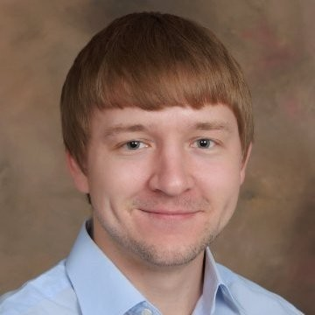
Meet your instructors
Juan Steibel
Austin Putz
AN S 562

Slide 4
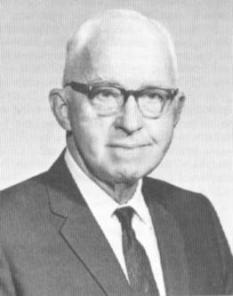
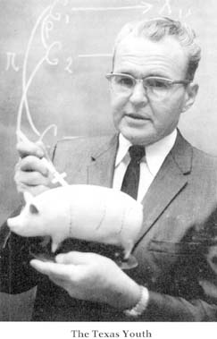
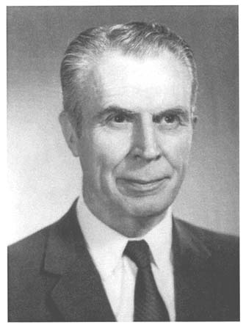
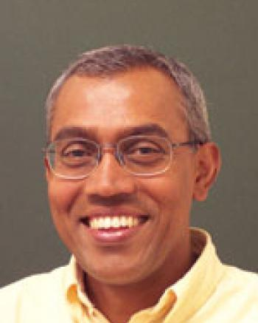
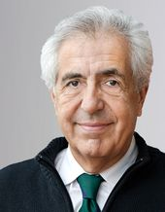
Why this class?
Long standing tradition of using linear mixed models in animal breeding and genetics
Single most used models in quantitative genetics today
Predicting breeding values
Predicting phenotypes
Estimating contribution of sources of variation to phenotypes
Inferences in multilevel models
Jay Lush
Lanoy Hazel
ISU
ISU
Charles Henderson
Rohan Fernando
Daniel Gianola
ISU graduate student
ISU
AN S 562

Slide 5
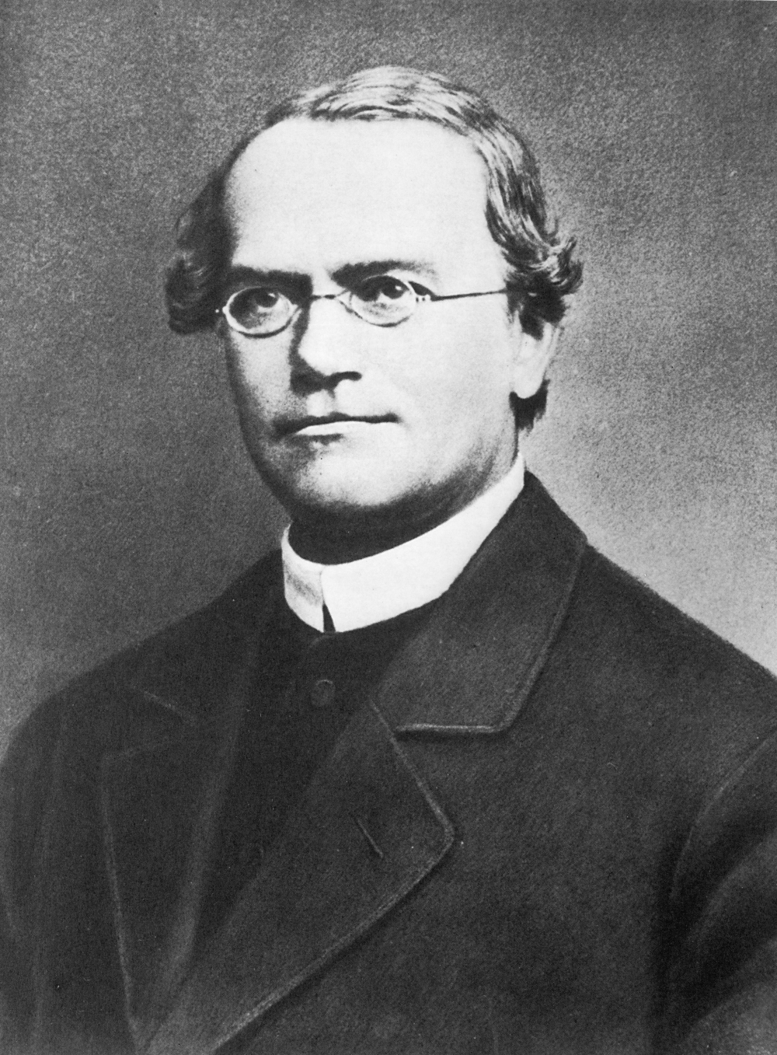
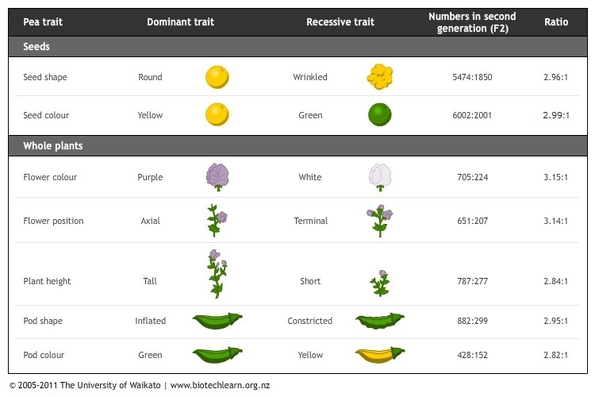
(Quantitative?) genetics
Gregor Mendel worked with his model organism (peas) in a 10 year long (started in 1850s) experiment ☺. He barely used any statistics at all. He is considered a founding father of genetics.
We are not Mendel, that’s why we must learn statistics.
AN S 562

Slide 6
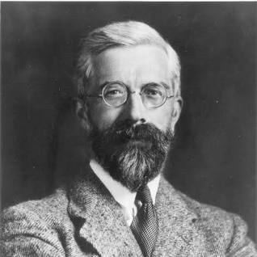
Linear models and quantitative genetics
Introduced the term “variance” and justified its importance in the study of inheritance.
Presented methods to estimate variances (the term ANOVA was born)
Linear models existed before Fisher, but he introduced their use in genetics
Ronald Fisher. 1918. “The Correlation between Relatives on the Supposition of Mendelian Inheritance”. Transactions of the Royal Society of Edinburgh. 52: 399–433.
AN S 562

Slide 7
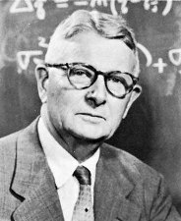
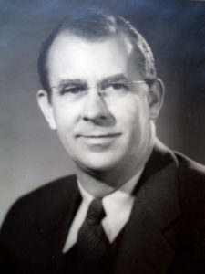
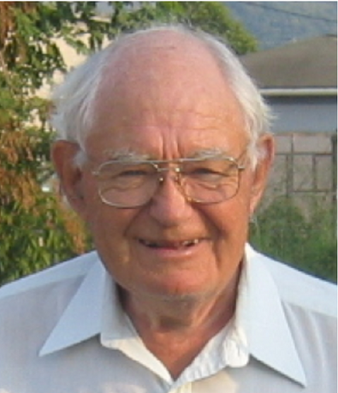
Linear models and animal breeding
Sewall Wright: Path analysis
R. Fischer: Analysis of Variance
Jay Lush: Individual vs Family performance
Lanoy Hazel: Selection Index
C. R. Henderson: BLUP
Gianola & Fernando: Bayesian methods in animal breeding
Shaley Searle: linear models & matrix algebra
AN S 562

Slide 8


A word on genetic evaluation and sources of information
Measure Phenotype of:
Obtain:
Parents
x
Parent average: What the candidate should be
Selection candidates
Own record: What the candidate seems to be
progeny
progeny record: What the candidate is

Slide 9





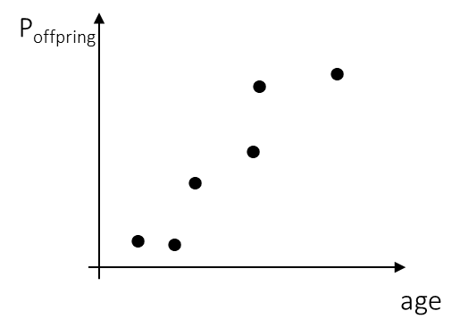
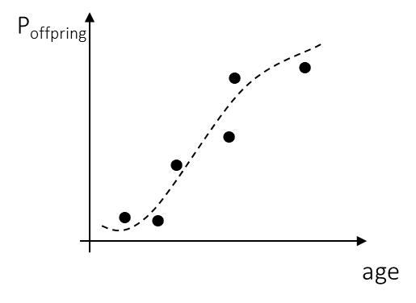
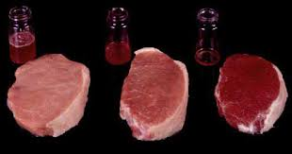
A motivating problem: Estimating the genetic merit of a candidate for selection
BV
P_{offpring}
●   
●   
●   
●   
Slope: h²
There is a linear model solution for all these cases
(and that’s why we will learn about this together in this course)
Slope: h²
P
(P_{sire}+ P_{dam})/2
AN S 562

Slide 10

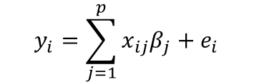


What is a linear model?
residuals
Questions to the class
predictors
Response
Identify each element here:
$$y_{i}=\sum_{j=1}^{p}{x_{ij}β_{j}}+e_{i}$$
$w_{i}=β_{0}+x_{i}β_{l}+x_{i}^{2}β_{q}+$ $e_{i}$
Linear coefficients
(unknown)
What are the parameters to estimate?
Residuals are random variables:
$$e_{i}\sim f(θ)$$
What is the difference between prediction and estimation?
$$e_{i}\sim N({0,σ}_{e}^{2})$$
This is a “single level model”
AN S 562

Slide 11

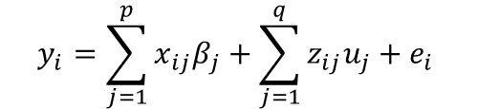
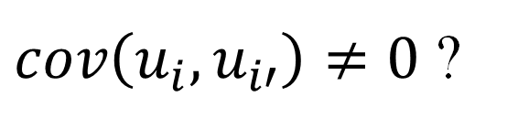

A more complex model
residuals
predictors
Questions to the class
Response
How to decide if an effect is fixed or random?
If the range of your data is having all the levels that you need for the analysis, then such might be used as a fixed effect
$$y_{i}=\sum_{j=1}^{p}{x_{ij}β_{j}}+\sum_{j=1}^{q}{z_{ij}u_{j}}+e_{i}$$
Linear coefficients
(unknown)
More random variables:
Give examples of fixed and random effects in models you work(ed) with?
$$e_{i}\sim N({0,σ}_{e}^{2})$$
$$u_{i}\sim N({0,σ}_{u}^{2})$$
This model is multilevel
$cov\left(u_{i},u_{i′}\right)≠0$ ?

Slide 12

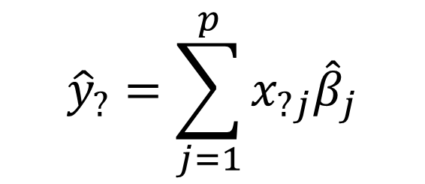

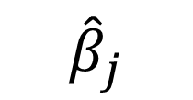
How to solve a simple linear model
residuals
predictors
Response
$$y_{i}=\sum_{j=1}^{p}{x_{ij}β_{j}}+e_{i}$$
$$e_{i}\sim N(0,σ_{e}^{2})$$
Estimate the mean response at certain value of x
Linear coefficients
(unknown)
Inference: estimation
Inference: hypothesis testing
What are the parameters to estimate?
$${\hat{β}}_{j}$$
$${\hat{σ}}_{e}^{2}$$
Predict response at certain value of x
$${\hat{y}}_{?}=\sum_{j=1}^{p}{x_{?j}{\hat{β}}_{j}}$$
prediction
How about this?:
AN S 562

Slide 13
universal steps of data analysis
Data
Model elicitation
Model fit
Model Checking
Specify:
Linear model and its assumptions
Compare:
Predicted quantities with observed quantities
Obtain:
Estimate parameter
Predict random quantities

Slide 14

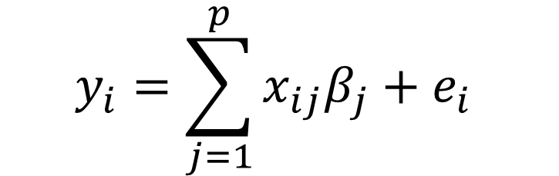
Model elicitation and fit
It’s much easier to work with matrix notation (Thanks Dr. S. Searle!!!)
$$y_{i}=\sum_{j=1}^{p}{x_{ij}β_{j}}+e_{i}$$
$$y=Xb+e$$

Slide 15
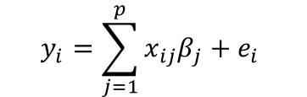

The fixed effects (single level model) is a great place to start:
$$y_{i}=\sum_{j=1}^{p}{x_{ij}β_{j}}+e_{i}$$
$$e_{i}\sim N(0,σ_{e}^{2})$$
Estimation of linear parameters and error variance:
Ordinary Least Squares and Maximum Likelihood
Estimation of expectations and prediction of new observations
Model checking

Slide 16
Mixed effects model
Mixed model equations
Generalized least squares
Estimation (BLUE) and prediction (BLUP)
Model checking: prediction accuracy
Cross validation

Slide 17
Applications to animal (and plant) breeding
Relationship matrices
Pedigree based
Marker-based
Others (?)

Slide 18
Applications to animal (and plant) breeding
Predicting breeding values:
Using progeny records (sire model)
Using records from all individual (single record)
Accuracy of predictions
Spring break!!!
End of Part A

Slide 19
Applications to animal (and plant) breeding
More advanced models:
Repeated measured (e.g: growth and lactation curves)
Social effects and maternal effects

Slide 20
Estimation of variance components
Up to this point we will assume that all variances are known:
Here we will learn different procedures to estimate variances
We will practice with software
End of Part B
Summer!!!

Slide 21
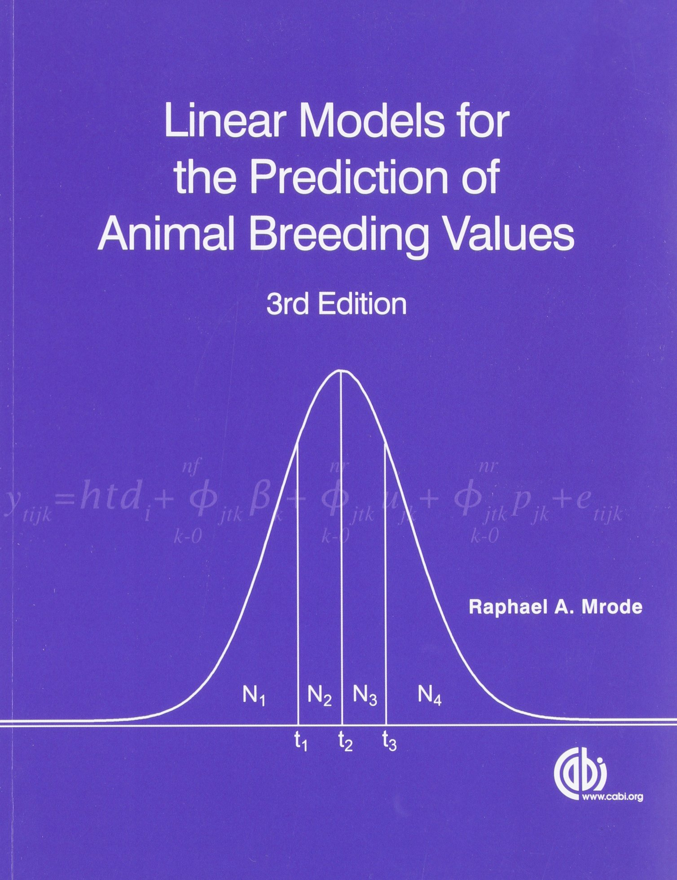
Resources
Linear Models and Animal Breeding. Lawrence R. Schaeffer. Centre for Genetic Improvement of Livestock. Department of Animal and Poultry Science. University of Guelph.
Available online (google)

Slide 22
Grading
AN S 562 | Item | %
A | Homework | 40
 | Final Project | 60
B | Homework | 40
 | Final Project | 60
Take a look on the syllabus!

Slide 23
Final project
We will provide a dataset and a general question.
You will analyze and write a report
Use any tool you want
You will have the freedom to:
Decide which model to fit
How to fit it
Check it or not
This replaces the final exam

Slide 24
How to stay up to date with the course
Come to class or watch the recording.
Follow along the demos and try to finish all practices
Come to office hours (open doors or appt)
Read some papers (readings will be suggested)

Slide 25
Lab (demo) today: simple linear regression with R
Learning objectives:
Students will review how to fit a simple linear regression model in R using LM and extract quantities of interest
Students will apply model checking using simulations and residual analyses
In the context of the course, this lab sets the stage for the next weeks where students will

Slide 26
Longley dataset
From datasets package
A macroeconomic data set which provides a well-known example for a highly collinear regression.
A data frame with 7 economical variables, observed yearly from 1947 to 1962 (n=16).
Highly colinear = lots of redundancy in predictors.

Slide 27
Longley dataset
Variables
GNP.deflator: GNP implicit price deflator (1954=100)
GNP: Gross National Product.
Unemployed: number of unemployed.
Armed.Forces: number of people in the armed forces.
Population: ‘noninstitutionalized’ population \ge≥ 14 years of age.
Year: the year (time).
Employed: number of people employed.

Slide 28
Lab activities
Fit model using LM
Extract slope, intercept
Extract residuals and predicted
Build graphics
Extract residual SD
Simulate residuals
Simulate data
Represent in a graphic

